Slide 1
CECS 579: Information Security Project Presentation Title: HACK CAPTCHA
TEAM: KARISHMA MEHTA

Slide 2
Contents
Abstract
Introduction
Literature Review
Problem Statement
Challenges
Solutions
Details of Implementation
Shortcomings
Lessons learned
Implementation/Results
Conclusion/Future Work

Slide 3
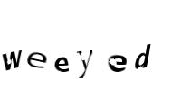
Abstract
A CAPTCHA (Completely Automated Public Turing Test To Tell Computers and Human Apart)^{[1]} is a program which helps websites protect against bots by randomly generating tests which humans can pass but a computer or a bot cannot pass.
The essential thing to break a CAPTCHA is that it’s the tricky task to teach a computer how to process an image how a human decodes it.
This project is based on attacking the security of the system rather than enhancing the security.

Slide 4
Introduction
CAPTCHA can be also called as a win-win solution, which means that if a bot is not able to break it, it provides a layer of security, but if it is able to break it automatically, that shows that a difficult task in computer vision has been solved
Even though the problem of breaking CAPTCHA is related to security domain, but solution to this problem is not related to security domain. When it comes to breaking CAPTCHA, we need to develop artificial intelligence in machines which help them recognize text in images.

Slide 5
Introduction
The various phases of algorithm in Machine learning are composed of:
Image Preprocessing
Segmentation
Feature Extraction
Character Recognition
In this project I have implemented kNN algorithm to break the CAPTCHA.
This algorithm is simple to understand, provides high success rate and is generally used in the scope of classifying characters.

Slide 6
Literature Search
Nowadays, CAPTCHAs are designed to be so difficult that it prevents any algorithm to break them, but still a lot of significant work has been done to break these CAPTCHAs.
A recent research, ^{[4]} reveals that is difficult to achieve “segmentation” than “recognition” since there are many machine learning algorithms which can efficiently solve the character recognition problem, but there is no effective general algorithm to handle the segmentation problem.

Slide 7
Problem Statement
An image of randomly scrambled letters is dynamically created. Since these letters are a part of an image and not text, it becomes difficult for a spam bot or other computer program to read.
In this project, I am looking forward to implement this algorithm with good success rate. The problem is related to Artificial Intelligence with Optimal Character Recognition problem.

Slide 8
Challenges
Few challenges of this project are as follows:
The challenging part in this project is segmentation. The success of breaking CAPTCHA is hidden in having proper segmentation
Being a new learner in python, faced some difficulties to know and code in Python.
In breaking CAPTCHA, if the process of segmentation is not well done, then entire system breaks out
Another important thing to consider for the success of this project is wide variety of training set.

Slide 9
Solution

Slide 10
Individual work
Hack CAPTCHA has three main modules which I am targeting to achieve:
Main GUI
Front end of the system which will deal with taking the input CAPTCHA image from the user. After successful processing it, we should be able to break the CAPTCHA and calculate the success percent
Generating data
In the context of this project, we would like to have multiple samples of letter ‘a’, ‘b’, ’c’ and so on. This kind of data is generated from the test images itself by reading the input image and further segmenting it to images of individual letter

Slide 11
Individual Work
Train and Test data:
Training is the process which performs and produces two data structures namely:
1. Set of classifications each image is in
2. Set of images
In the testing phase we simply, try to uncover the English letter corresponding to the classified image.

Slide 12
Shortcomings and their reason
Following are the shortcomings of the project:
The application can’t be said as 100% accurate
The application works for only characters A-Z and a-z
The application works for this specific type of CAPTCHA
Reasons for the shortcoming:
To enhance system accuracy, it is necessary to have a huge training set of data. Since the training set is limited to 198 images in my application, it won’t be able to provide high accuracy
As the images I got over Internet didn’t contain numbers, so I focused only on characters
Due to the complexity of work and timeline of the project, scope was restricted to one type of CAPTCHA. Also being individually doing the project, it wouldn’t be possible to complete it alone

Slide 13
Lessons Learned
I learnt a new programming language.
Even though I couldn’t master that language, but made sure that what each function did.
I took help from online articles which demonstrated how Image Processing works in Python^{[6]}.
I learned the new libraries like OpenCV and NumPy which are used for Image Processing in Python.
Since I am very much interested in Data Mining, this project’s implementation is related to data mining aspect, but has significance in security domain.

Slide 14
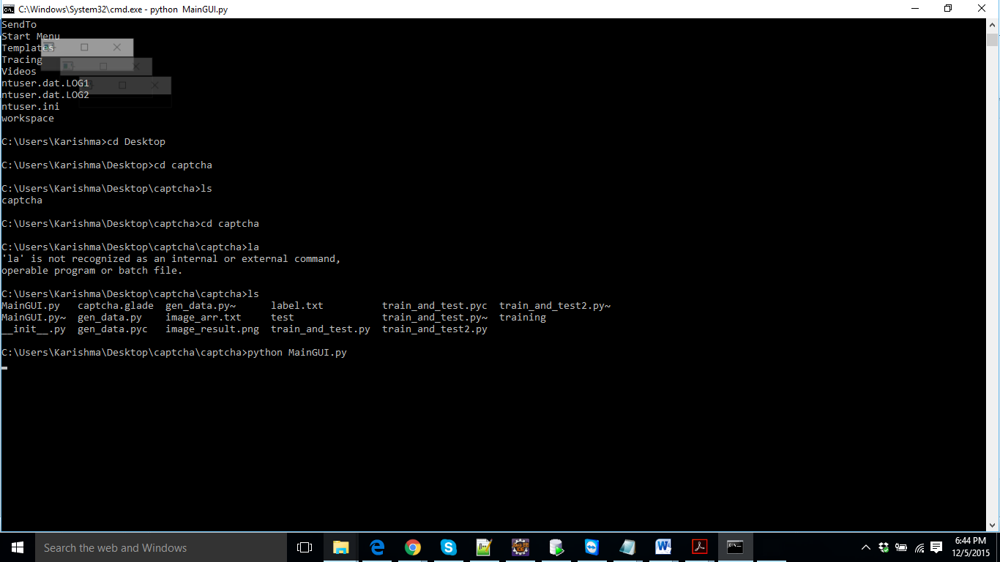
Implementation/Results

Slide 15
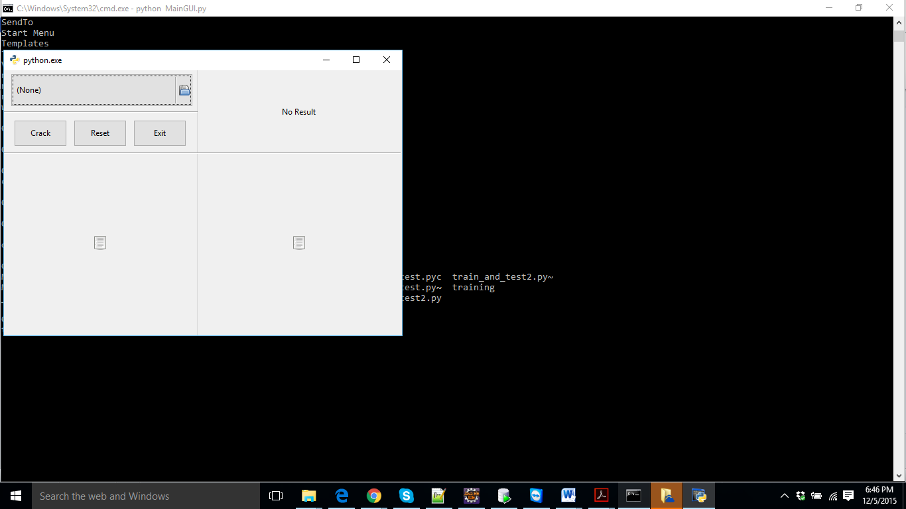
Implementation/Results

Slide 16
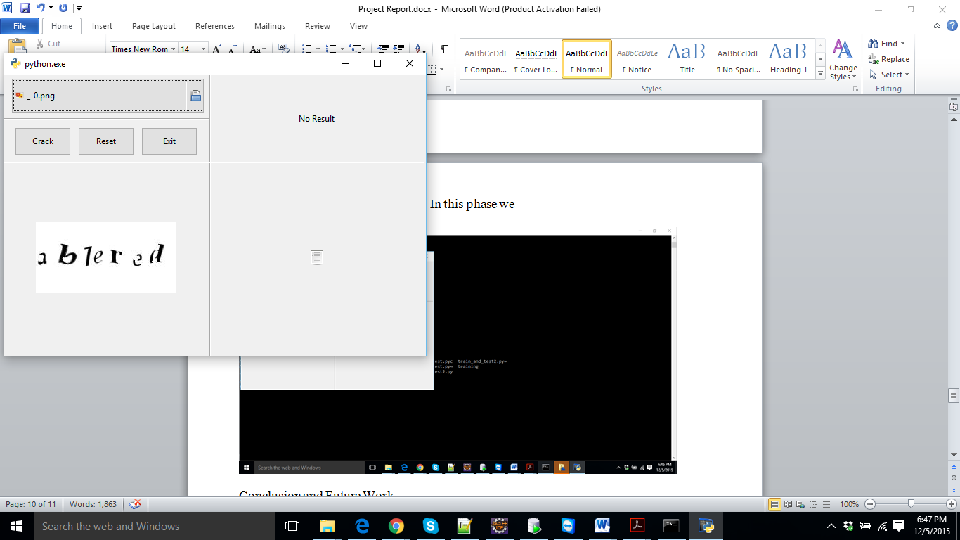
Implementation/Results

Slide 17
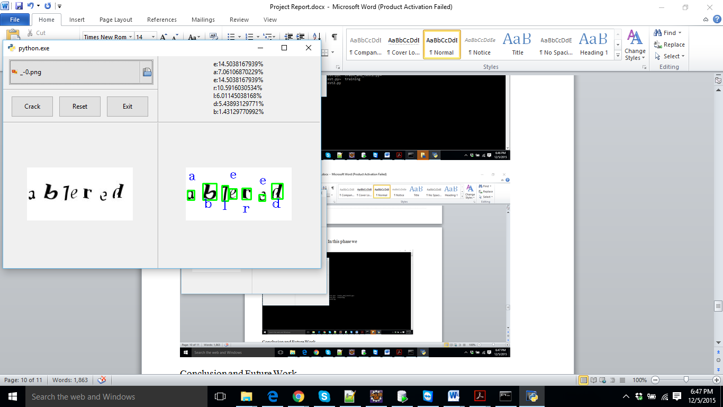
Implementation/Results

Slide 18
Conclusion
To conclude, we were able to develop a system which could successfully break the text based CAPTCHA using the machine learning algorithm.
Even though the system was built complete, it still lacks a few more functionalities:
Getting CAPTCHA from live site. For example: Ebay. Yahoo.com etc
Generating large amount of training set to enhance the reliability and accuracy of the system
Widening the scope of CAPTCHA by working on different types of CAPTCHA’s
Enhancing CAPTCHA to include numbers also, not just keeping it limited to characters

